Slide 1

Matplotlib
IEEE EMBS
2026

Slide 2
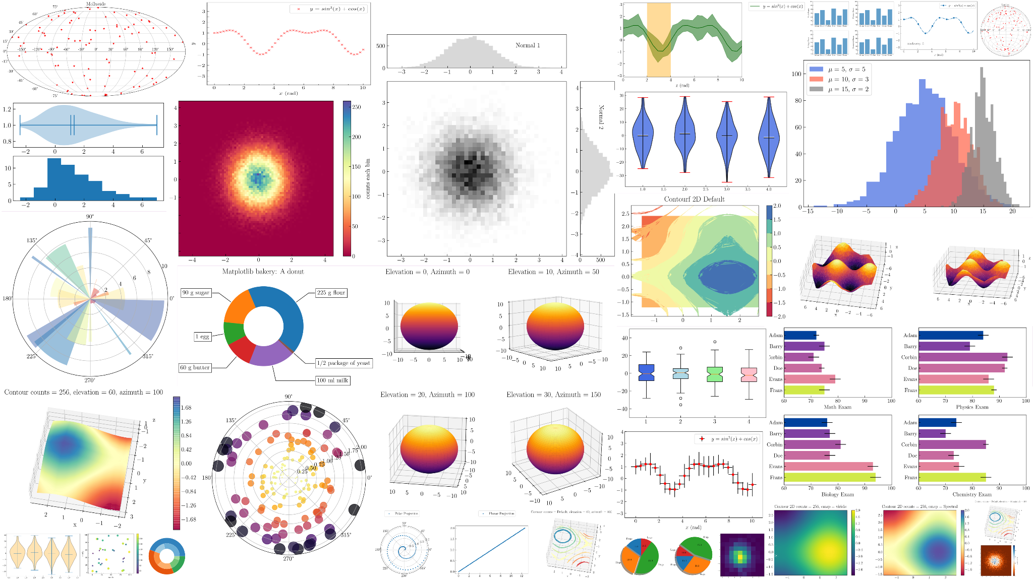
What is Matplotlib?
A Python library that is like a free version of Matlab. This library can help you make a wide array of informative and beautiful graphs.
https://towardsdatascience.com/visualizations-with-matplotlib-part-1-c9651008b6b8/

Slide 3
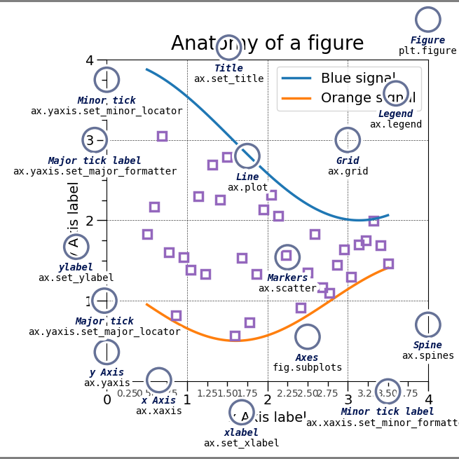
What info should your graph have?
TITLE <- what readers see first
Axis labels (with units!!)
Numbered tick marks
Caption
  Not added with matplotlib
Legend (if 2+ categories)
Depending on graph type: trendline, errors and error bars, hues, marker shapes, sizes, etc.
https://matplotlib.org/stable/gallery/showcase/anatomy.html (Includes the source code, which is meta and cool!)

Slide 4


WHAT WE’RE
ABOUT TO DO
Create your first graph in matplotlib to get the hang of things
Explore different methods for customizing your graph
Try different graph types and consider which ones may be most valuable

Slide 5
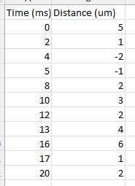
Part 1:
Making your First Graph
(Before we start, make sure that you have the data to the right in an Excel spreadsheet)

Slide 6
Can you ORDER the code on the next slide?
Step 1
Step 2
Step 3
Step 4
Step 5
Create Python file and import libraries
Read Excel or CSV (comma- separated value) file
Set axes using the data
Set labels (title, axes, units, legend, etc.)
SHOW THE GRAPH with plt.show()

Slide 7
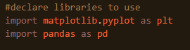

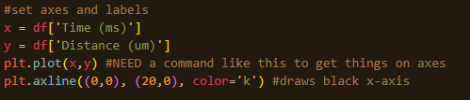
BONUS: where would
this block fit?

Slide 8
#2
#4
#5
#1
BONUS: where would
this block fit?
ANSWER!
#4.5
#3

Slide 9
Now, let’s see what the code makes!
I will be going around the room to help answer any questions.

Slide 10
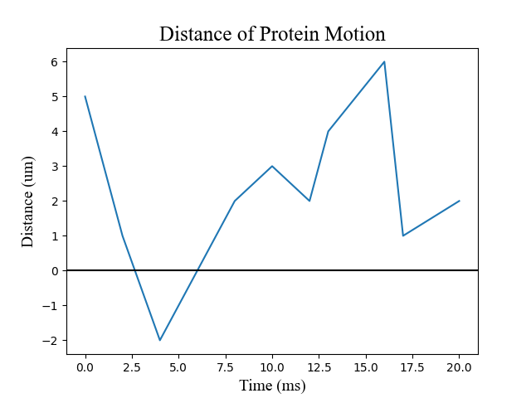
What if we try a different method?

Slide 11
Part 2:
Trying Different Methods

Slide 12
Replace “plot” with “scatter” in the code below.

Slide 13
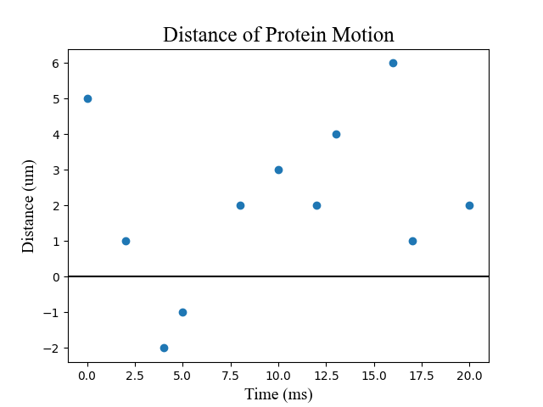
plt.plot(x,y)
plt.scatter(x,y)

Slide 14
What do YOU want to change next?
Hue?
Background?
Marker Shape?
Grid?

Slide 15
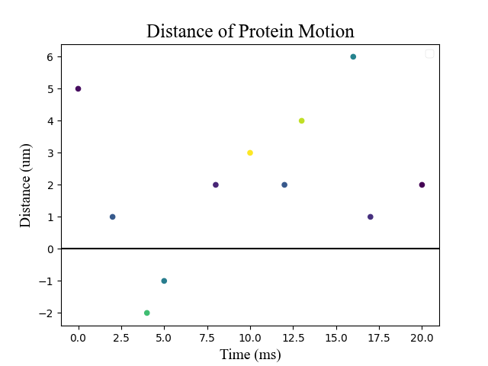
Hue
Add the ‘c’ parameter to the “scatter” method
Bonus: What’s missing in this graph?
← needs a third variable

Slide 16
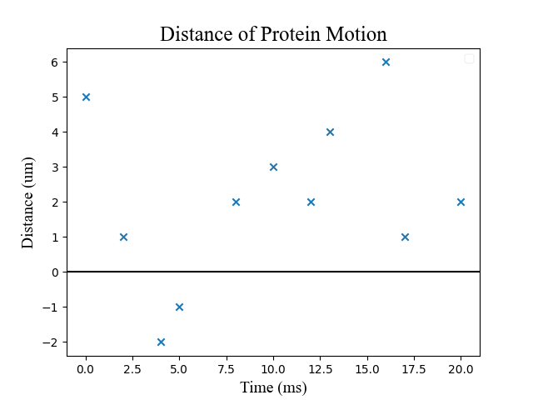
Marker Shape
Add the ‘marker’ parameter to the “scatter” method
A few other marker types:
‘o’ for O
‘x’ for X
‘*’ for star
‘s’ for square
‘D’ for diamond
etc.

Slide 17
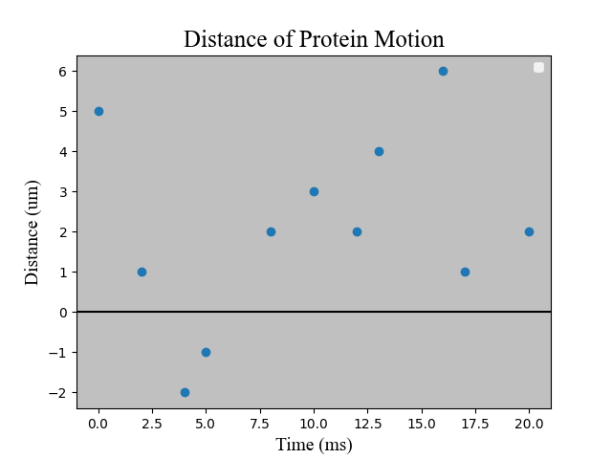

Background
Get the axes and set the face color BEFORE calling the “scatter” method

Slide 18
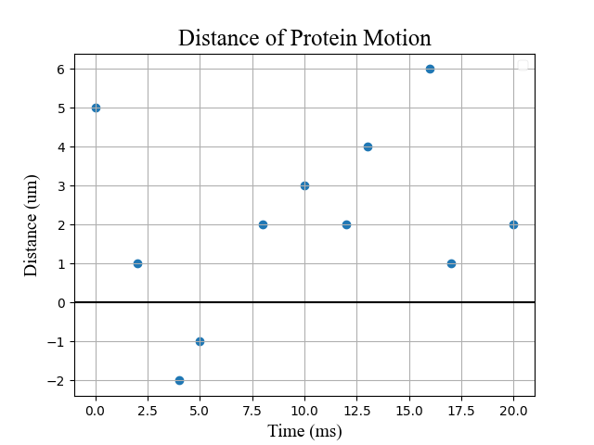

Grid
Just call plt.grid()
(I personally prefer to do this by the code that sets the style)
(also this command can go in any location in the code)

Slide 19
What other kinds of graphs can matplotlib make?

Slide 20
Part 3: Exploring Graph Types

Slide 21
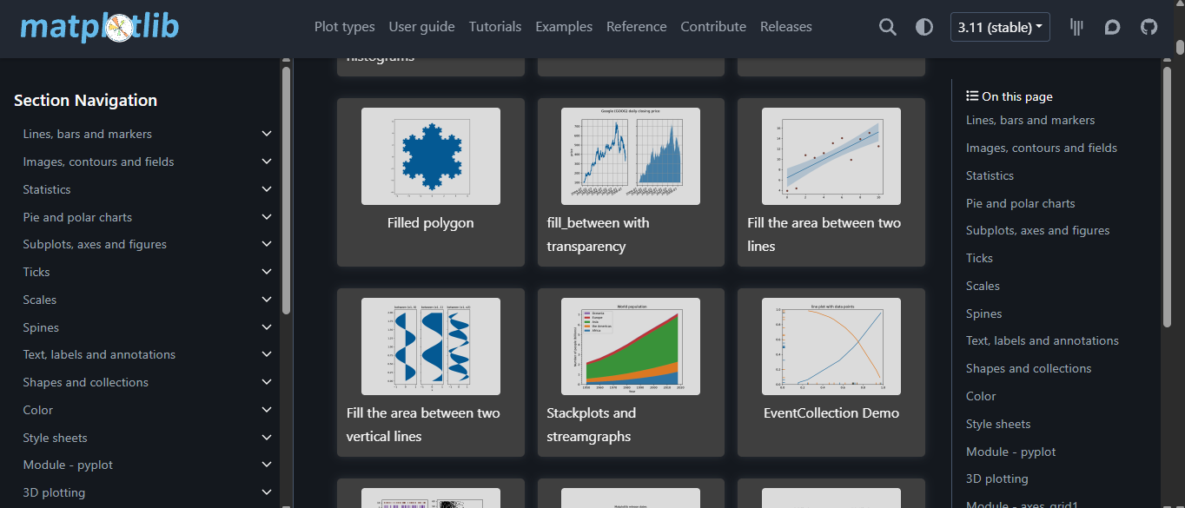
https://matplotlib.org/stable/gallery/index.html

Slide 22
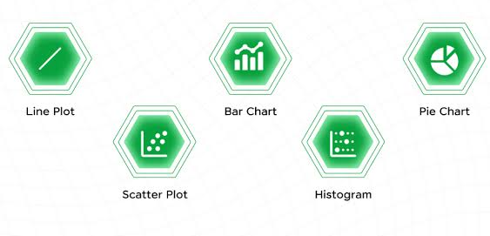
Choosing the Most Relevant Type of Graph For Your Data While Also Making It Look Nice and Impressive
Concise and precise communication?
Quantitative or Categorical data?
Discrete or Continuous data?
  Time Series - time is the x-variable; continuous
Third Variable?
Legend needed?
These are some of the main factors to consider, but other ones may come up
https://www.guvi.in/blog/fundamentals-of-matplotlib/

Slide 23
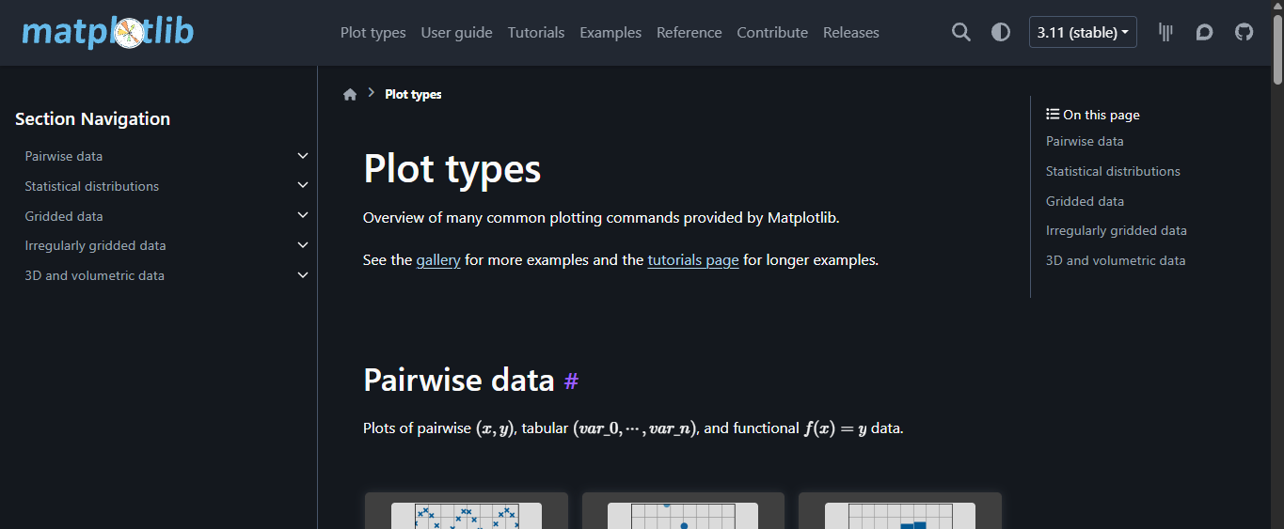
How to explore types of plots and their parameters: https://matplotlib.org/stable/plot_types/index.html

Slide 24
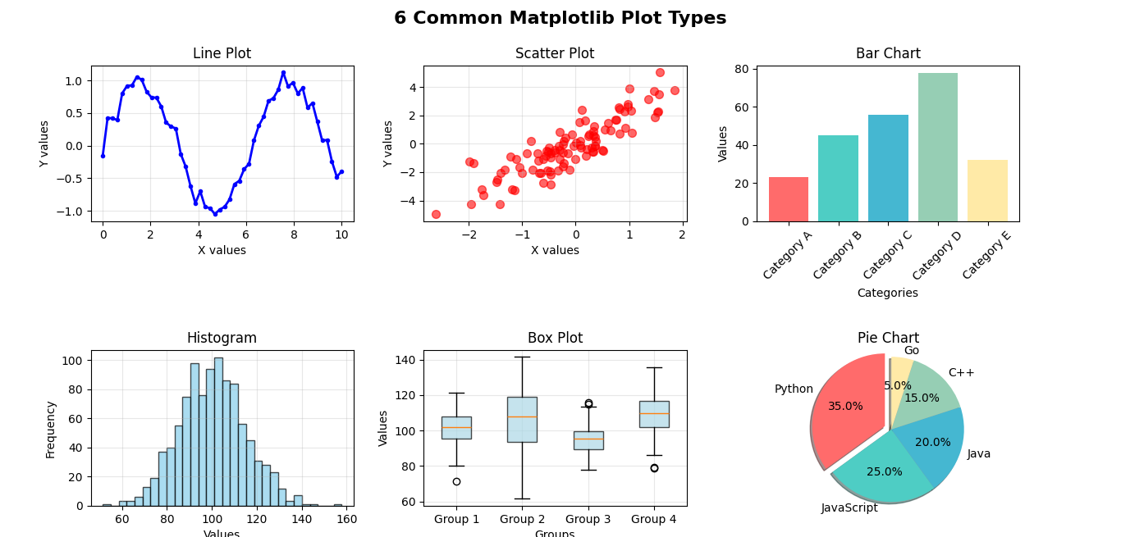
Brief Overview of Key Graphs
https://www.pythonsnacks.com/p/matplotlib-6-common-plots

Slide 25
THANK
YOU!

